Slide 1

OLIST BUSINESS ANALYSIS
Submission by -
Shashank Sacamuri

Slide 2
AGENDA
BACKGROUND
OBJECTIVE
KEY FINDINGS
RECOMMENDATIONS
APPENDIX

Slide 3

BACKGROUND
OList is an e-commerce company that has faced some losses recently and they want to manage their inventory very well so as to reduce any unnecessary costs that they might be bearing.
Help OList identify the product categories which they can get rid of without significantly impacting business.

Slide 4

OBJECTIVE
Identify top selling products by sales quantity and revenue.
Conduct pareto analysis to identify only the few product categories which contribute to 80% of sales.
Perform Market Basket Analysis to identify frequently purchased products, bought either individually or together as a combination of products.

Slide 5
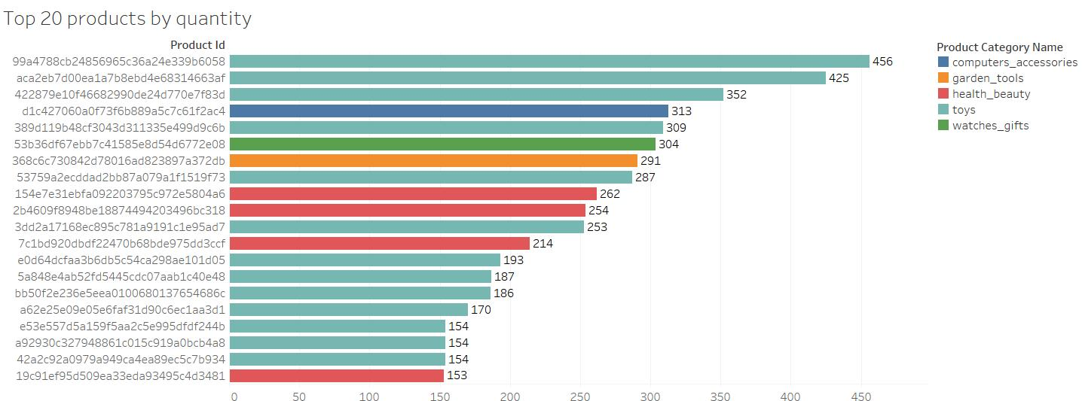
TOP PRODUCTS BY SALES QUANTITY
Among the top 20 products by volume, toys constitute the major purchases followed by health_beauty related products.
Link to final recommendations

Slide 6
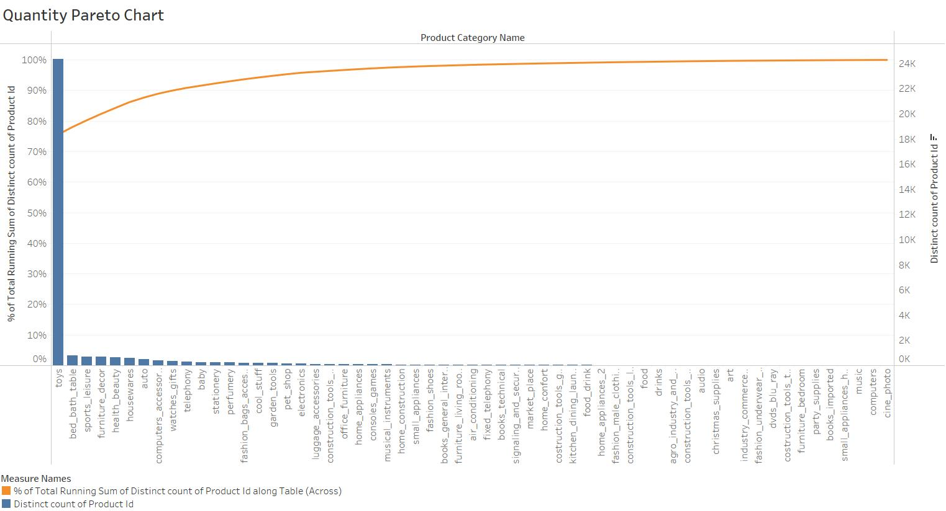
ANALYSIS OF SALES QUANTITY
The top 3 product categories explain 80% of the sales quantity, which are toys, bed_bath_table and sports_leisure based products.

Slide 7
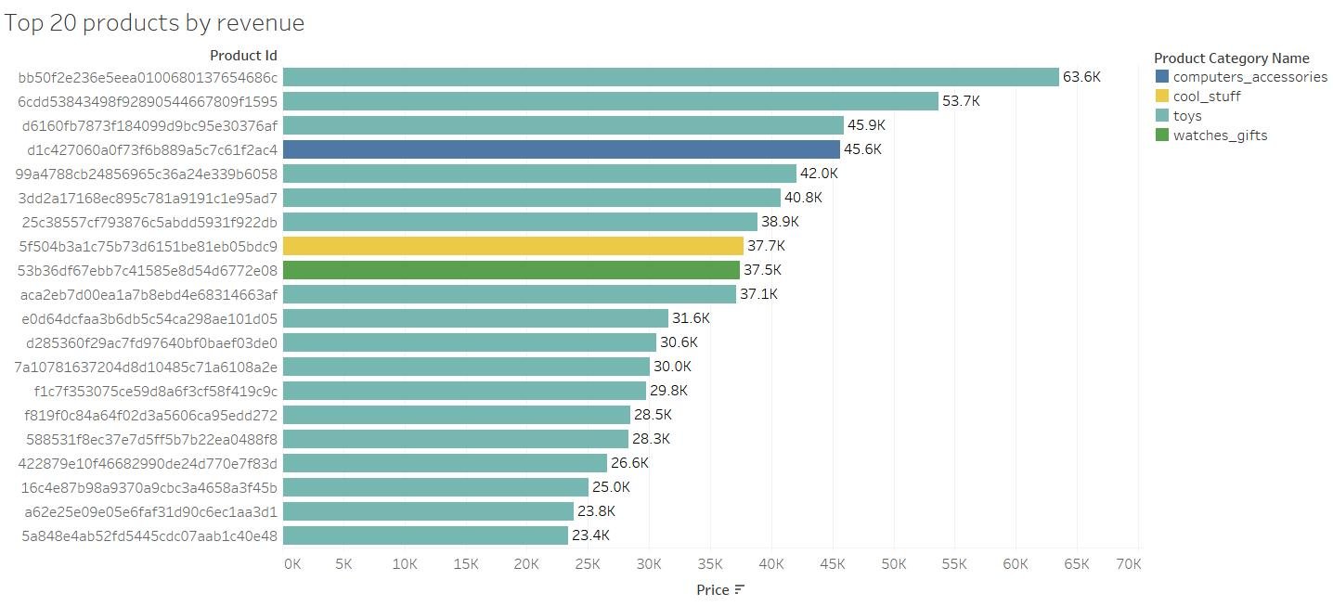
TOP PRODUCTS BY SALES REVENUE
Among the top 20 products by revenue, toys constitute the major purchases followed by computer accessories.
Link to final recommendations

Slide 8
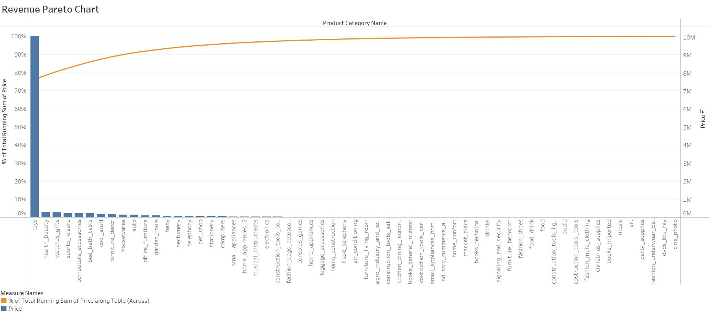
ANALYSIS OF SALES REVENUE
The top 3 product categories explain 80% of the sales revenue, which are toys, health_beauty and watches_gifts based products.

Slide 9
MARKET BASKET ANALYSIS (RAW RESULTS)
antecedents | consequents | antecedent support | consequent support | support | confidence | lift | leverage | conviction
frozenset({'060cb19345d90064d1015407193c233d'}) | frozenset({'98d61056e0568ba048e5d78038790e77'}) | 0.000556741 | 0.000695927 | 0.000231976 | 0.416666667 | 598.7222222 | 0.000231588 | 1.713092697
frozenset({'e256d05115f9eb3766f3ab752132a4e2'}) | frozenset({'1dc7685f4fdb9622d84ae2ec658d5bbf'}) | 0.000324766 | 0.000278371 | 0.000139185 | 0.428571429 | 1539.571429 | 0.000139095 | 1.749512851
frozenset({'1dc7685f4fdb9622d84ae2ec658d5bbf'}) | frozenset({'e256d05115f9eb3766f3ab752132a4e2'}) | 0.000278371 | 0.000324766 | 0.000139185 | 0.5 | 1539.571429 | 0.000139095 | 1.999350469
frozenset({'2d27434c710806b971a721da337a112a'}) | frozenset({'86c43103446290e7efacad3701cd654d'}) | 0.000324766 | 0.000649531 | 0.000139185 | 0.428571429 | 659.8163265 | 0.000138974 | 1.74886332
frozenset({'1427b126f61597524866770b05d4eed2'}) | frozenset({'5526b1ae9ab2688cf600783cece249df'}) | 0.000320395 | 0.000366166 | 0.000137312 | 0.428571429 | 1170.428571 | 0.000137195 | 1.749359209
frozenset({'18486698933fbb64af6c0a255f7dd64c'}) | frozenset({'dbb67791e405873b259e4656bf971246'}) | 0.000457708 | 0.001556207 | 0.000228854 | 0.5 | 321.2941176 | 0.000228142 | 1.996887587
frozenset({'4d0ec1e9b95fb62f9a1fbe21808bf3b1'}) | frozenset({'9ad75bd7267e5c724cb42c71ac56ca72'}) | 0.000411937 | 0.001235811 | 0.000183083 | 0.444444444 | 359.6378601 | 0.000182574 | 1.79777554
frozenset({'ad0a798e7941f3a5a2fb8139cb62ad78'}) | frozenset({'946344697156947d846d27fe0d503033'}) | 0.000366166 | 0.000366166 | 0.000228854 | 0.625 | 1706.875 | 0.00022872 | 2.665690223
frozenset({'946344697156947d846d27fe0d503033'}) | frozenset({'ad0a798e7941f3a5a2fb8139cb62ad78'}) | 0.000366166 | 0.000366166 | 0.000228854 | 0.625 | 1706.875 | 0.00022872 | 2.665690223
frozenset({'e6b314a2236c162ede1a879f1075430f'}) | frozenset({'ad4b5def91ac7c575dbdf65b5be311f4'}) | 0.000274625 | 0.000228854 | 0.000183083 | 0.666666667 | 2913.066667 | 0.00018302 | 2.999313438
frozenset({'ad4b5def91ac7c575dbdf65b5be311f4'}) | frozenset({'e6b314a2236c162ede1a879f1075430f'}) | 0.000228854 | 0.000274625 | 0.000183083 | 0.8 | 2913.066667 | 0.00018302 | 4.998626877

Slide 10
MARKET BASKET ANALYSIS (MODIFIED RESULTS)
A | B | A occurrence in all transactions (%) | B occurrence in all transactions (%) | Frequency of occurrence of A & B in all the transactions (%) | Confidence of purchasing B when A is purchased (%) | Lift (Similar to Confidence but takes into account popularity of B)
toys A | toys B | 0.06 % | 0.07 % | 0.02 % | 41.67 % | 598.72
toys C | toys D | 0.03 % | 0.03 % | 0.01 % | 42.86 % | 1539.57
toys D | toys C | 0.03 % | 0.03 % | 0.01 % | 50.00 % | 1539.57
watches_gifts | toys E | 0.03 % | 0.06 % | 0.01 % | 42.86 % | 659.82
computers_accessories | toys F | 0.03 % | 0.04 % | 0.01 % | 42.86 % | 1170.43
toys G | toys H | 0.05 % | 0.16 % | 0.02 % | 50.00 % | 321.29
bed_bath_table | toys I | 0.04 % | 0.12 % | 0.02 % | 44.44 % | 359.64
toys J | toys K | 0.04 % | 0.04 % | 0.02 % | 62.50 % | 1706.88
toys K | toys J | 0.04 % | 0.04 % | 0.02 % | 62.50 % | 1706.88
toys L | toys M | 0.03 % | 0.02 % | 0.02 % | 66.67 % | 2913.07
toys M | toys L | 0.02 % | 0.03 % | 0.02 % | 80.00 % | 2913.07

Slide 11
BUSINESS RECOMMENDATIONS
In terms of Sales Quantity
In terms of customers
Focus on toys, bed_bath_table and sports_leisure based product categories.
Target those customers who have kids and offer attractive offers to them.
In terms of Sales Revenue
In terms of reduction in expenditure
Focus on toys, health_beauty and watches_gifts based product categories.
Do not stock up on those product categories purchased less than 5 times.
In terms of product groupings
Focus on sales of toys either individually or toys being sold with other popular product categories.
Link to top products by qty
Link to top products by revenue

Slide 12
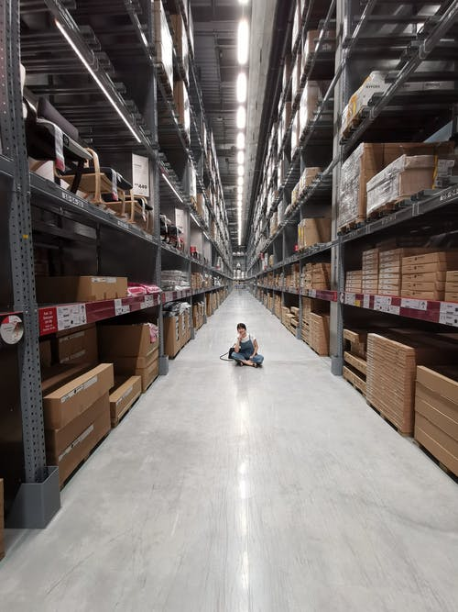
APPENDIX
This presentation is supplemented with the following documents –
Data cleaning notebook
Market Basket Analysis notebook
Tableau workbook (containing visualizations and dashboards)
Assumptions used to arrive at the final results –
Considered only those product categories purchased more than 5 times
Confidence >= 40% (to arrive at product groupings)

